Slide 1


MICHAEL VENTURA
07/01/2024

Slide 2

Outline
Executive Summary
Introduction
Methodology
Results
Conclusion
Appendix

Slide 3
Executive Summary
Summary of methodologies
SpaceX Data Collection using SpaceX API
SpaceX Data Collection with Web Scraping
SpaceX Data Wrangling
SpaceX Exploratory Data Analysis using SQL
SpaceX EDA DataViz Using Python Pandas and Matplotlib
SpaceX Launch Sites Analysis with Folium-Interactive Visual Analytics and Ploty Dash
SpaceX Machine Learning Landing Prediction
Summary of all results
EDA Results
Interactive Visual Analytics and Dashboards
Predictive Analysis

Slide 4
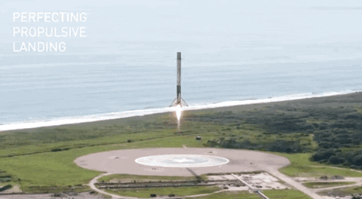
Introduction
Project background and context
SpaceX advertises Falcon 9 rocket launches on its website with a cost of 62 million dollars; other providers cost upward of 165 million dollars each, much of the savings is because SpaceX can reuse the first stage.
Therefore if we can determine if the first stage will land, we can determine the cost of a launch, This information can be used if an alternative company wants to bid against SpaceX for a rocket launch.
Problems you want to find answers
This capstone has the purpose to predict if the Falcon 9 first stage will land successfully using data from Falcon 9 rocket launches advertised on its website.

Slide 5

Section 1

Slide 6
Methodology
Executive Summary
Data collection methodology:
Describe how data was collected
Perform data wrangling
Describe how data was processed
Perform exploratory data analysis (EDA) using visualization and SQL
Perform interactive visual analytics using Folium and Plotly Dash
Perform predictive analysis using classification models
How to build, tune, evaluate classification models

Slide 7
Data Collection
Describe how data sets were collected.
Data was first collected using SpaceX API by making a get request to the SpaceX API. This was done by first defining a series helper functions that would help in the use of the API to extract information using identification numbers in the launch data and then requesting rocket launch data from the SpaceX API url.
Finally to make the requested JSON results more consistent, the SpaceX launch data was requested and parsed using the request and then decoded the response content as a JSON result witch was then converted into a Pandas Data Frame

Slide 8
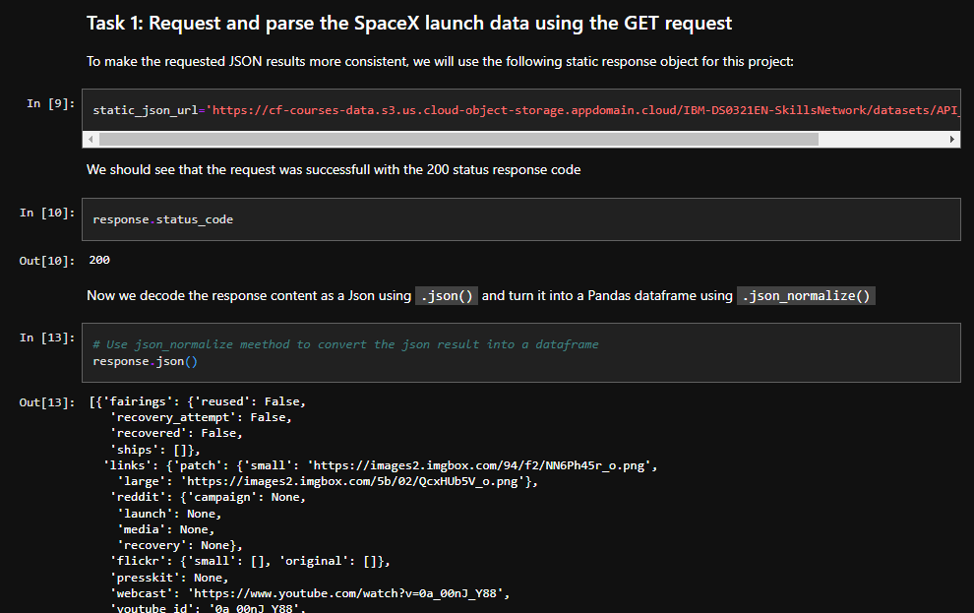
Data Collection – SpaceX API
Data Collected using SpaceX API by making a get request to the SpaceX API then requested and parsed the SpaceX launch data using the GET request and decoded the response content as a JSON result which was then converted into a Pandas Data Frame
Here is the GitHub URL of the completed SpaceX API calls notebook (https://github.com/michaelventura01/space_x_launch/blob/main/jupyter-labs-spacex-data-collection-api.ipynb).

Slide 9
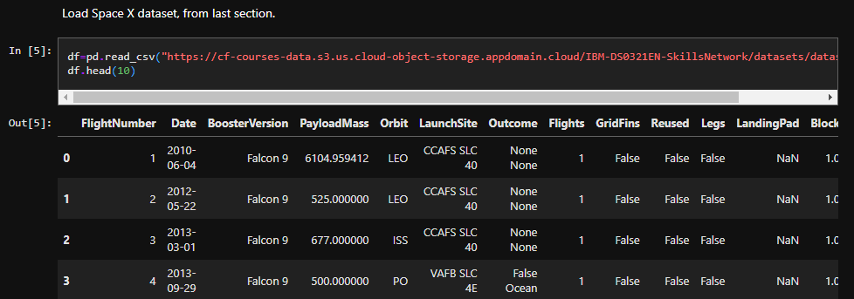
Data Collection - Scraping
After obtaining and creating a Pandas DF from the collected data, data was filtered using the BoosterVersion column to only keep the Falcon 9 launches, then dealt with the missing data values in the LandingPad and PayloadMass columns. For the PayloadMass, missing data values were replaced using mean value of column.
Here is the GitHub URL of the completed SpaceX web scraping notebook (https://github.com/michaelventura01/space_x_launch/blob/main/labs-jupyter-spacex-Data%20wrangling.ipynb)

Slide 10
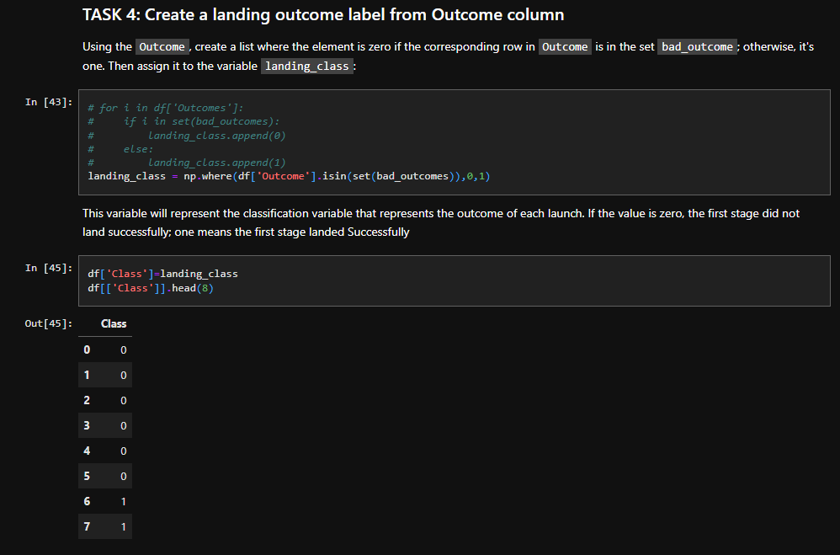
Data Wrangling
After obtaining and creating a Pandas DF from the collected data, data was filtered using the BoosterVersion column to only keep the Falcon 9 launches, then dealt with the missing data values in the LandingPad and PayloadMass columns. For the PayloadMass , missing data values were replaced using mean value of column.
Also performed some Exploratory Data Analysis (EDA) to find some patterns in the data and determine what would be the label for training supervised models
Here is the GitHub URL of the completed SpaceX data wrangling related notebooks, as an external reference and peer-review purpose
https://github.com/michaelventura01/space_x_launch/blob/main/labs-jupyter-spacex-Data%20wrangling.ipynb

Slide 11
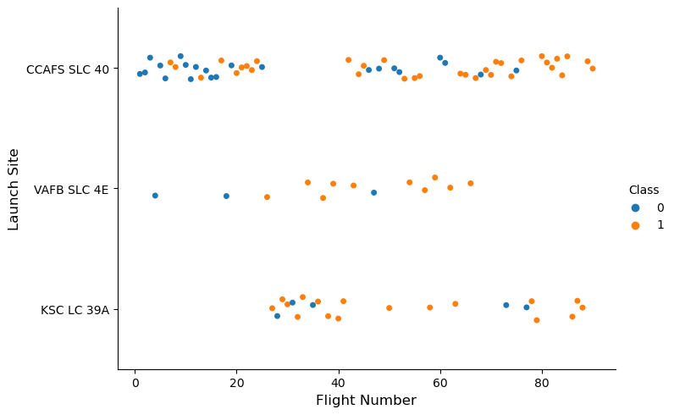
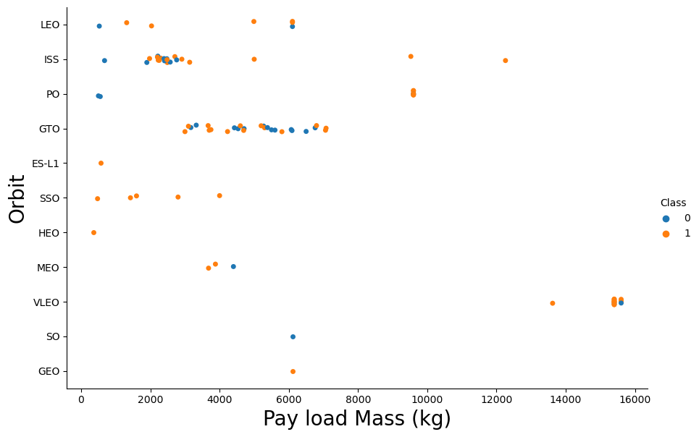
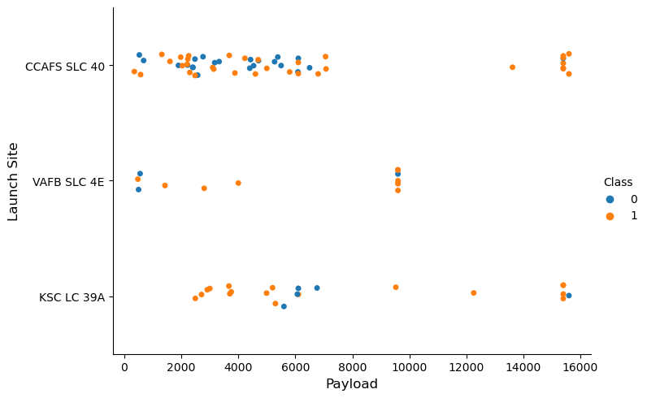
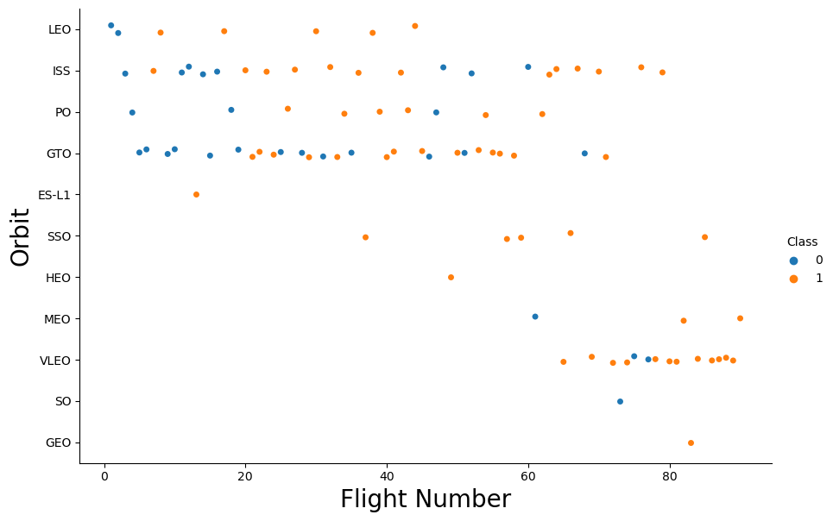
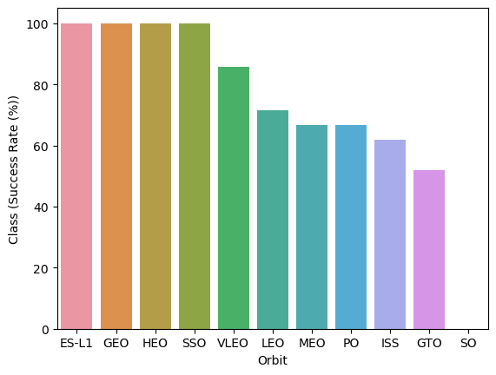
EDA with Data Visualization
Performed data Analysis and Feature Engineering using Pandas and Matplotlib.i.e.
Exploratory Data Analysis
Preparing Data Feature Engineering
Used scatter plots to Visualize the relationship between Flight Number and Launch Site, Payload and Launch Site, FlightNumber and Orbit type, Payload and Orbit type.
Used Bar chart to Visualize the relationship between success rate of each orbit type
Line plot to Visualize the launch success yearly trend.
Here is the GitHub URL of the completed SpaceX EDA with data visualization notebook (https://github.com/michaelventura01/space_x_launch/blob/main/edadataviz.ipynb)

Slide 12
EDA with SQL
The following SQL queries were performed for EDA
Display the names of the unique launch sites in the space mission
Display 5 records where launch sites begin with the string 'CCA‘
Display the total payload mass carried by boosters launched by NASA (CRS)
Display average payload mass carried by booster version F9 v1.

Slide 13
Build an Interactive Map with Folium
Created folium map to marked all the launch sites, and created map objects such as markers, circles, lines to mark the success or failure of launches for each launch site.
Created a launch set outcomes (failure=0 or success=1)
Here is the GitHub URL of the completed SpaceX of your completed interactive map with Folium map, as an external reference and peer-review purpose (https://github.com/michaelventura01/space_x_launch/blob/main/lab_jupyter_launch_site_location.ipynb)

Slide 14
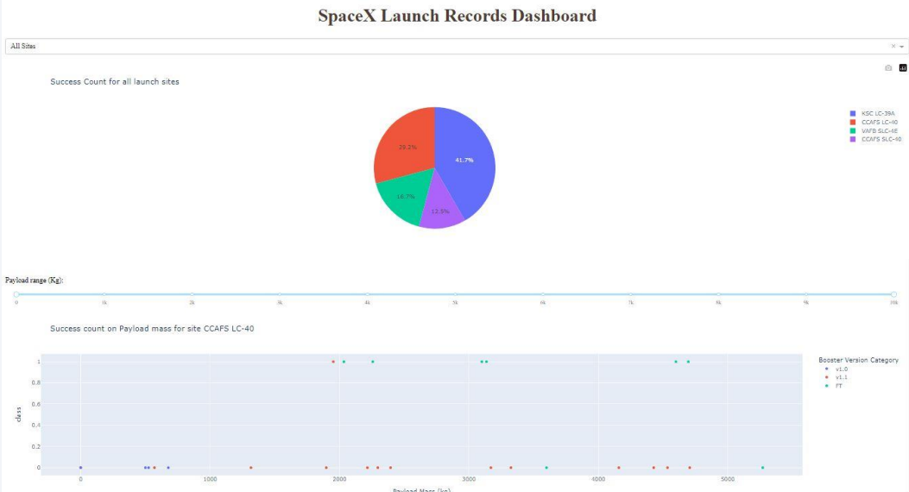
Build a Dashboard with Plotly Dash
Built an interactive dashboard application with Plotly dash by:
Adding a Launch Site Drop-down Input Component
Adding a callback function to render success-pie-chart based on selected site dropdown
Adding a Range Slider to Select Payload
Addeng a callback function to render the success-payload-scatter-chart scatter plot
Here is the GitHub URL of the completed SpaceX of your completed Plotly Dash lab, as an external reference and peer-review purpose(https://github.com/michaelventura01/space_x_launch/blob/main/spacex_app/spacex_dash_app.py)

Slide 15
Predictive Analysis (Classification)
Summary of how I built, evaluated, improved, and found the best performing classification model
After loading the data as a Pandas Dataframe, I set out to perform exploratory Data Analysis and determine Training Labels by;
creating a NumPy array from the column Class in data, by applying the method to_numpy() then assigned it to the variable Y as the outcome variable.
Then standardized the feature dataset (x) by transforming it using preprocessing.StandardScaler() function from Sklearn.
After which the data was split into training and testing sets using the function train_test_split from sklearn.model_selection with the test_size parameter set to 0.2 and random_state to 2.

Slide 16
Predictive Analysis (Classification)
In order to find the best ML model/ method that would performs best using the test data between SVM, Classification Trees, k nearest neighbors and Logistic Regression;
First created an object for each of the algorithms then created a GridSearchCV object and assigned them a set of parameters for each model.
For each of the models under evaluation, the GridsearchCV object was created with cv=10, then fit the training data into the GridSearch object for each to Find best Hyperparameter.
After fitting the training set, we output GridSearchCV object for each of the models, then displayed the best parameters using the data attribute best_params_ and the accuracy on the validation data using the data attribute best_score_.
Finally using the method score to calculate the accuracy on the test data for each model and plotted a confussion matrix for each using the test and predicted outcomes.

Slide 17
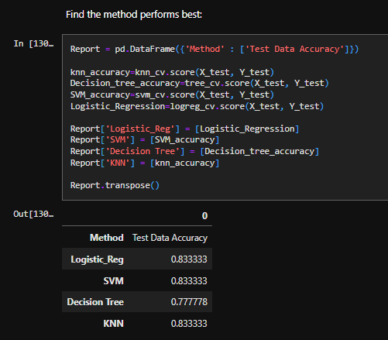
Predictive Analysis (Classification)
The table below shows the test data accuracy score for each of the methods comparing them to show which performed best using the test data between SVM, Classification Trees, k nearest neighbors and Logistic Regression;
Here is the GitHub URL of the completed SpaceX of predictive analysis (https://github.com/michaelventura01/space_x_launch/blob/main/SpaceX_Machine%20Learning%20Prediction_Part_5.ipynb)

Slide 18
Results
Exploratory data analysis results
Interactive analytics demo in screenshots
Predictive analysis results

Slide 19

Section 2

Slide 20
Flight Number vs. Launch Site
Scatter plot of Flight Number vs Launch Site

Slide 21
Payload vs. Launch Site
Show a scatter plot of Payload vs. Launch Site

Slide 22
Success Rate vs. Orbit Type
Show a bar chart for the success rate of each orbit type

Slide 23
Flight Number vs. Orbit Type
Show a scatter point of Flight number vs. Orbit type

Slide 24
Payload vs. Orbit Type
Show a scatter point of payload vs. orbit type

Slide 25
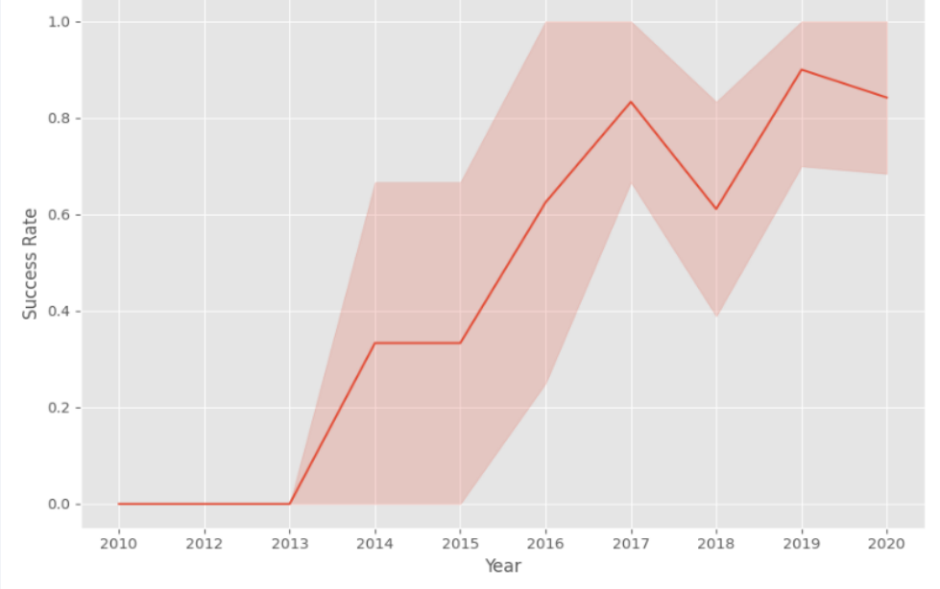
Launch Success Yearly Trend
Show a line chart of yearly average success rate

Slide 26
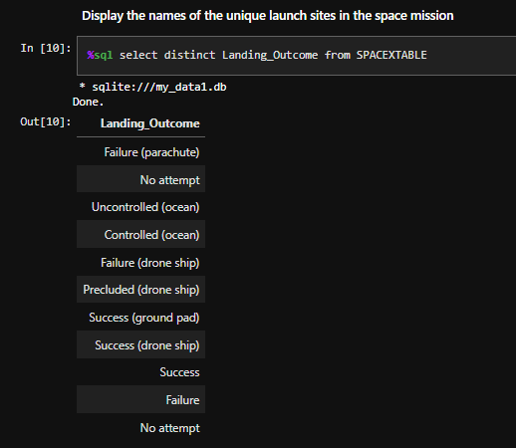
All Launch Site Names
Find the names of the unique launch sites

Slide 27
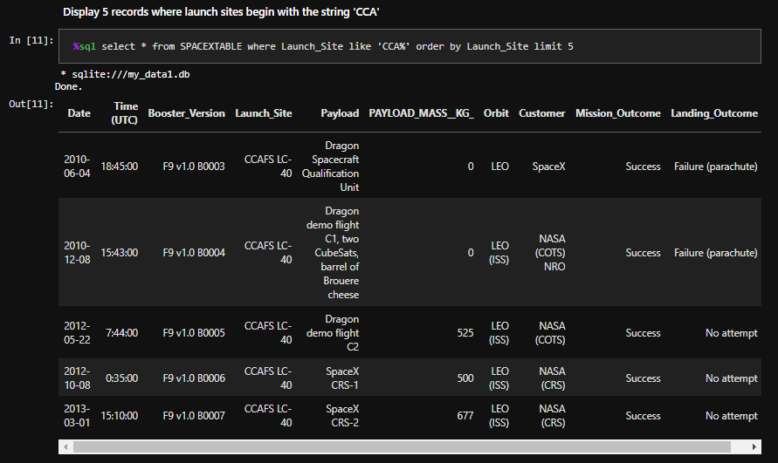
Launch Site Names Begin with 'CCA'
Find 5 records where launch sites begin with `CCA`

Slide 28
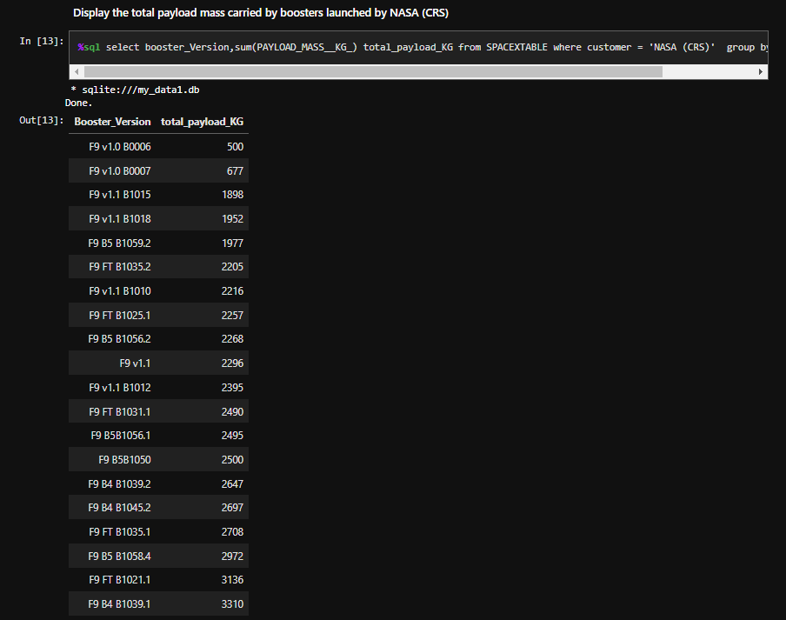
Total Payload Mass
Calculate the total payload carried by boosters from NASA

Slide 29
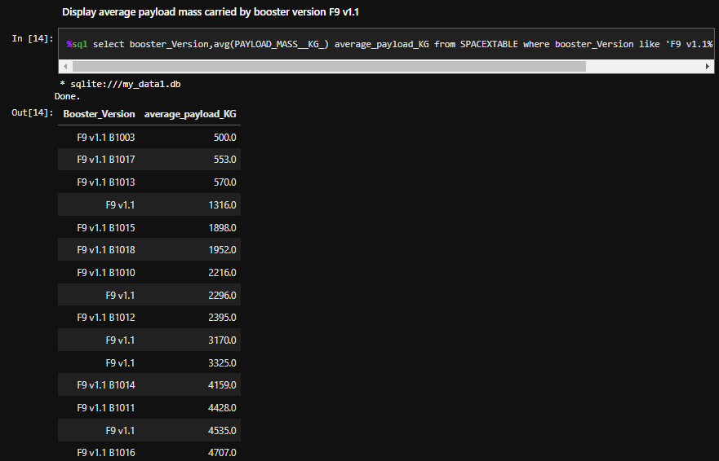
Average Payload Mass by F9 v1.1
Calculate the average payload mass carried by booster version F9 v1.1

Slide 30
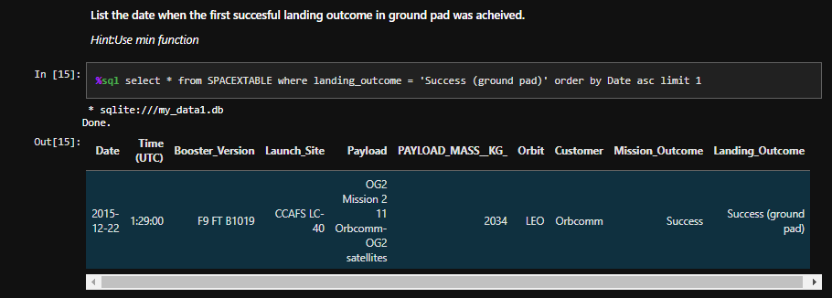
First Successful Ground Landing Date
Find the dates of the first successful landing outcome on ground pad

Slide 31
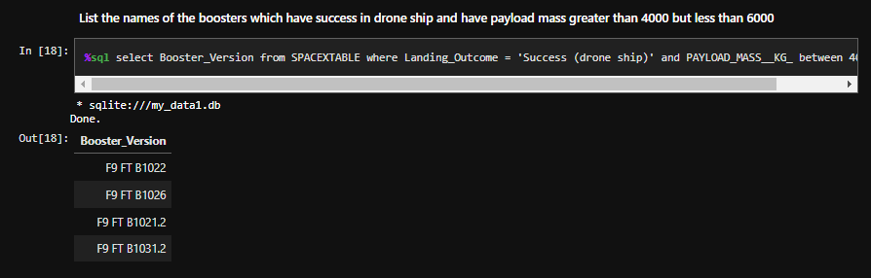
Successful Drone Ship Landing with Payload between 4000 and 6000
List the names of boosters which have successfully landed on drone ship and had payload mass greater than 4000 but less than 6000

Slide 32
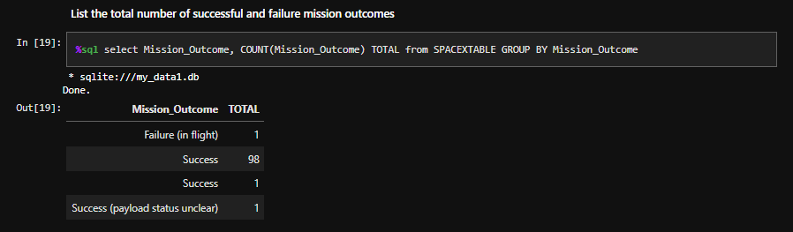
Total Number of Successful and Failure Mission Outcomes
Calculate the total number of successful and failure mission outcomes

Slide 33
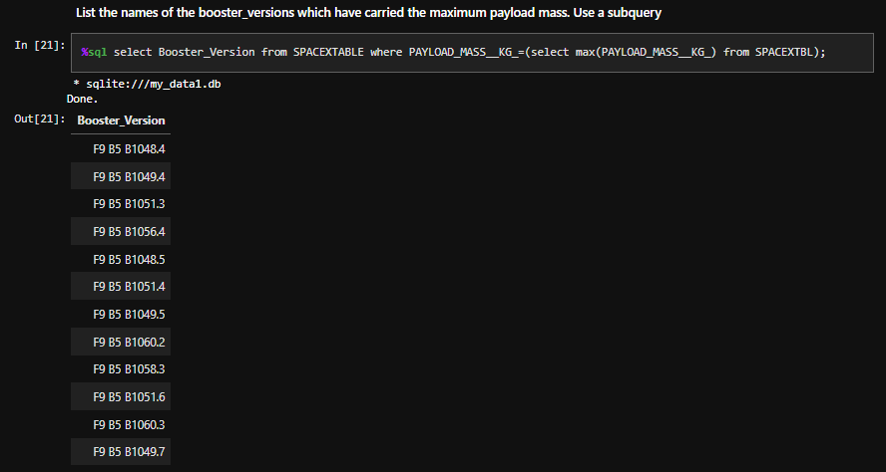
Boosters Carried Maximum Payload
List the names of the booster which have carried the maximum payload mass

Slide 34
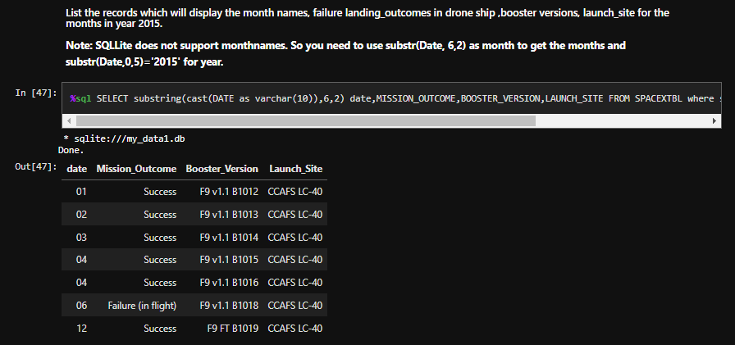
2015 Launch Records
List the failed landing_outcomes in drone ship, their booster versions, and launch site names for in year 2015

Slide 35
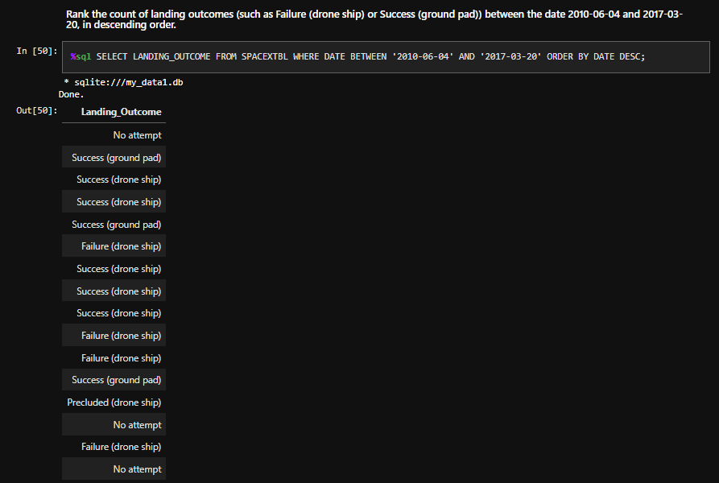
Rank Landing Outcomes Between 2010-06-04 and 2017-03-20
Rank the count of landing outcomes (such as Failure (drone ship) or Success (ground pad)) between the date 2010-06-04 and 2017-03-20, in descending order

Slide 36

Section 3

Slide 37

Mark all launch sites on a map
All launch sites are in proximity to the Equator, (located southwards of the US map). Also all the laumch sites are in very close proximity to the coast.

Slide 38
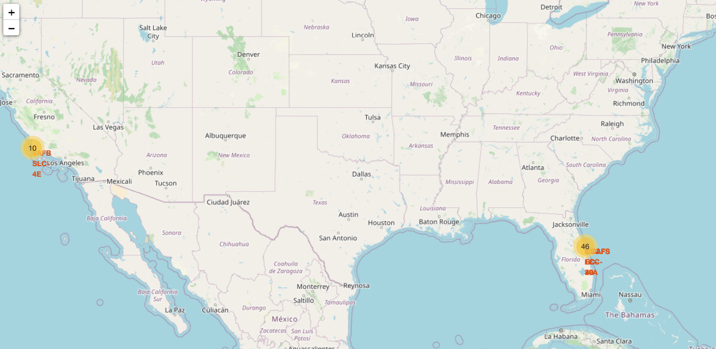

Mark the success/failed launches for each site on the map
All launch sites are in proximity to the Equator, (located southwards of the US map). Also all the laumch sites are in very close proximity to the coast.

Slide 39

Distances between a launch site to its proximities
In the Eastern coast (Florida) Launch site KSC LC-39A has relatively high success rates compared to CCAFS SLC-40 & CCAFS LC-40.

Slide 40

Section 4

Slide 41
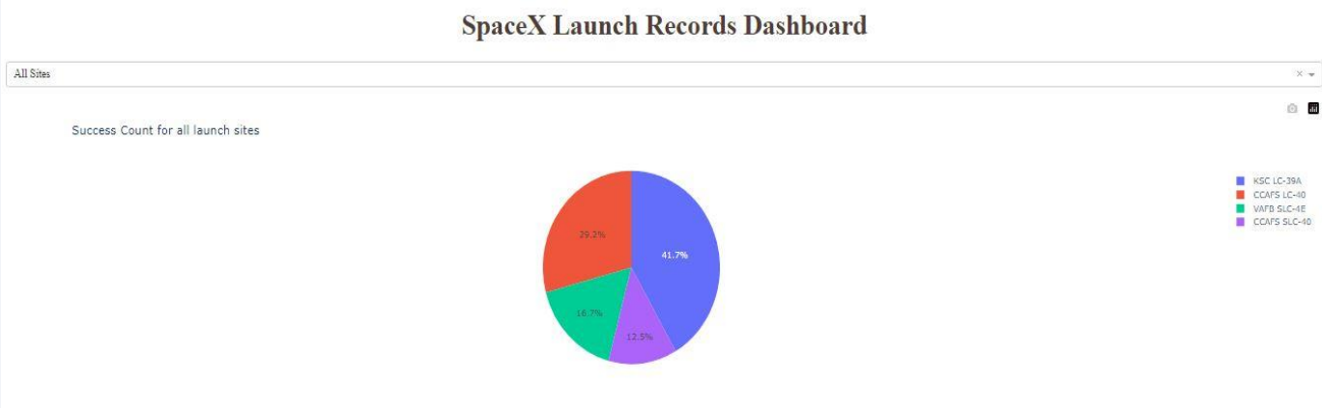
Pie-Chart for launch success count for all sites
Launch site KSC LC-39A has the highest launch success rate at 42% followed by CCAFS LC-40 at 29%, VAFB SLC-4E at 17% and lastly launch site CCAFS SLC-40 with a success rate of 13%

Slide 42
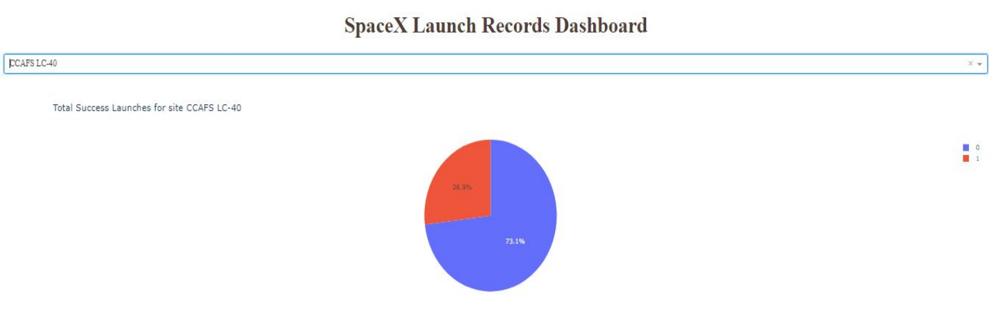
Pie chart for the launch site with 2 nd highest launch success ratio
Launch site CCAFS LC-40 had the 2nd highest success ratio of 73% success against 27% failed launches

Slide 43
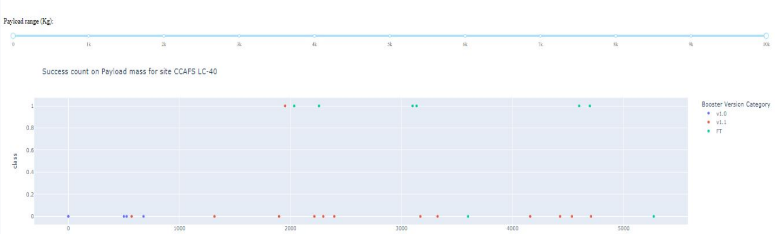
Payload vs. Launch Outcome scatter plot for all sites
For Launch site CCAFS LC-40 the booster version FT has the largest success rate from a payload mass of >2000kg

Slide 44

Section 5

Slide 45
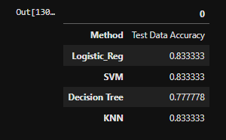
Classification Accuracy
Visualize the built model accuracy for all built classification models, in a bar chart

Slide 46
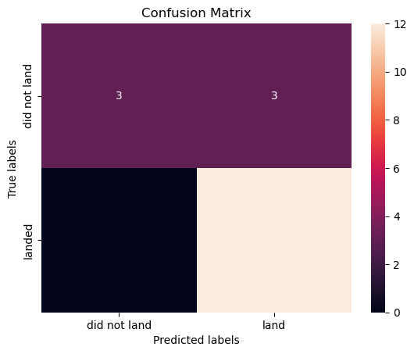
Confusion Matrix
Show the confusion matrix of the best performing model with an explanation

Slide 47
Conclusions
Different launch sites have different success rates. CCAFS LC-40, has a success rate of 60 %, while KSC LC-39A and VAFB SLC 4E has a success rate of 77%.
We can deduce that, as the flight number increases in each of the 3 launcg sites, so does the success rate. For instance, the success rate for the VAFB SLC 4E launch site is 100% after the Flight number 50. Both KSC LC 39A and CCAFS SLC 40 have a 100% success rates after 80th flight
If you observe Payload Vs. Launch Site scatter point chart you will find for the VAFB-SLC launchsite there are no rockets launched for heavypayload mass(greater than 10000).
Orbits ES-L1, GEO, HEO & SSO have the highest success rates at 100%, with SO orbit having the lowest success rate at ~50%. Orbit SO has 0% success rate.
LEO orbit the Success appears related to the number of flights; on the other hand, there seems to be no relationship between flight number when in GTO orbit

Slide 48
Appendix
With heavy payloads the successful landing or positive landing rate are more for Polar,LEO and ISS. However for GTO we cannot distinguish this well as both positive landing rate and negative landing(unsuccessful mission) are both there here
Anf finally the sucess rate since 2013 kept increasing till 2020.

Slide 49


